Slide 1
Process Description and Control
Chapter 3

Slide 2
Major Requirements of an OS
Interleave the execution of several processes to maximize processor utilization while providing reasonable response time
Allocate resources to processes
Support interprocess communication and user creation of processes

Slide 3
Process
Also called a task
Execution of an individual program
Can be traced
  list the sequence of instructions that execute

Slide 4
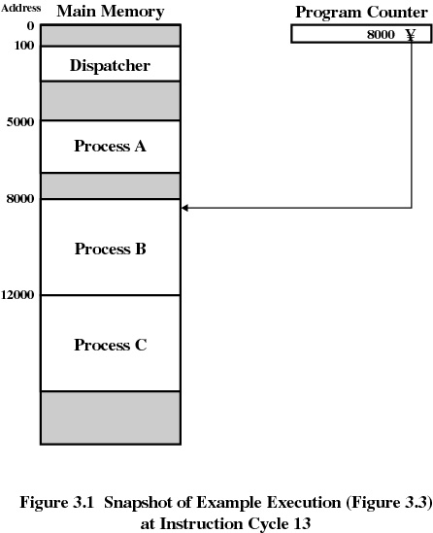

Slide 5
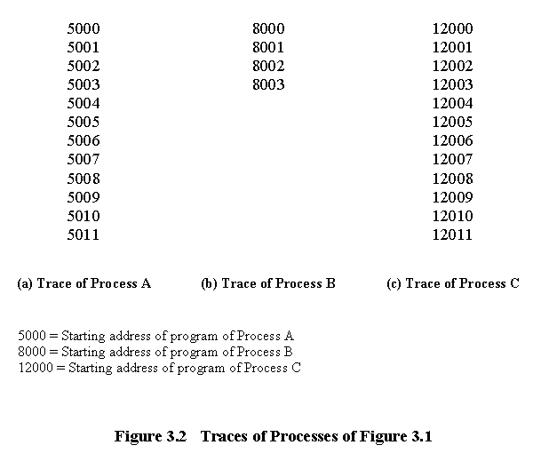

Slide 6
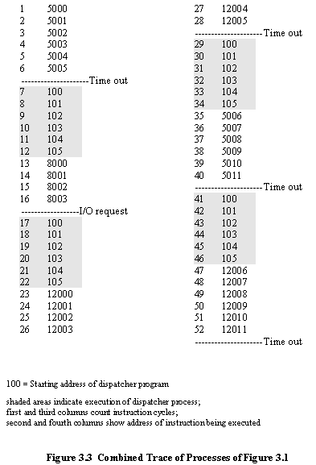

Slide 7
Context Switch
Process Descriptor
CPU
Process Descriptor

Slide 8
Invoking the Scheduler
Need a mechanism to call the scheduler
Voluntary call
  Process blocks itself (e.g. sleep(); wait())
  ➔ scheduler is called
Involuntary call
  External force (interrupt) blocks the process
  (e.g. timer interrupt or interrupt from an external I/O device
  or a signal sent by another process via kill())
  ➔ scheduler is called

Slide 9
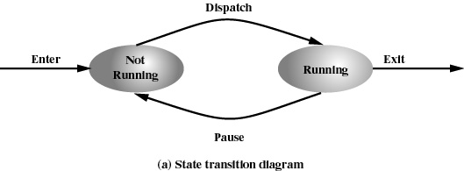
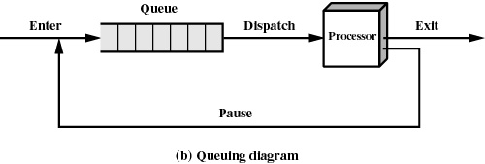
Two-State Process Model
Process may be in one of two states:

Slide 10
Process Creation
User logs on
Submission of a batch or a background job
Created to provide a service such as printing
  (e.g. deamons)
Process creates another process
(e.g. fork())

Slide 11
Process Termination
User logs off
Batch job issues Halt instruction
Quit an application
Error and fault conditions
External signals (e.g. kill())

Slide 12
Reasons for Process Termination
Normal completion
Time limit exceeded
Memory unavailable
Bounds violation
Protection error (example write to a read-only file)
Arithmetic error
Time overrun (process waited longer than a specified max. for an event)
I/O failure
Invalid instruction (happens when try to execute data)
Privileged instruction
Data misuse
Operating system intervention
  such as when deadlock occurs
Parent terminates so child processes terminate
Parent request

Slide 13
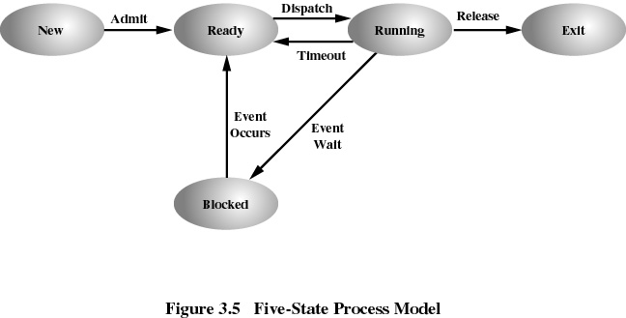
A Five-State Model
New
Ready
Running
Blocked
Exit

Slide 14
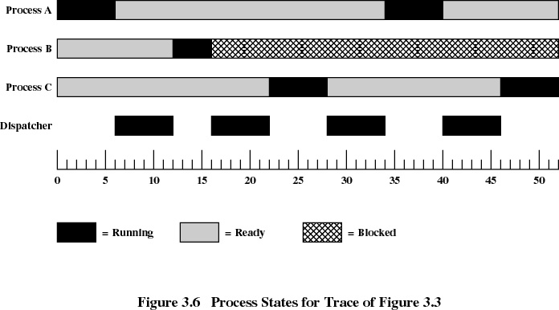

Slide 15
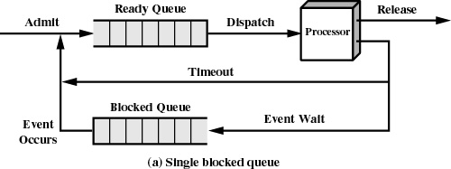
Using Two Queues

Slide 16
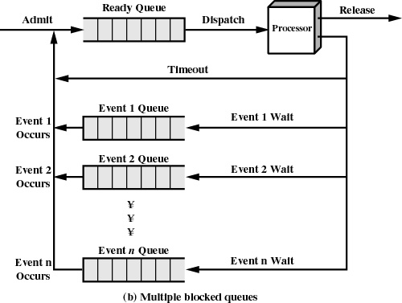

Slide 17
Suspended Processes
Processor is faster than I/O so some processes could be waiting for I/O
Swap these processes to disk to free up more memory
Blocked state becomes suspend state when swapped to disk
Two new states
  Blocked, suspend
  Ready, suspend

Slide 18
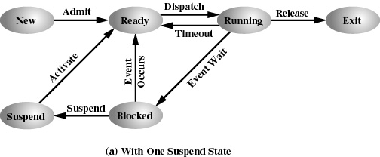
One Suspend State

Slide 19
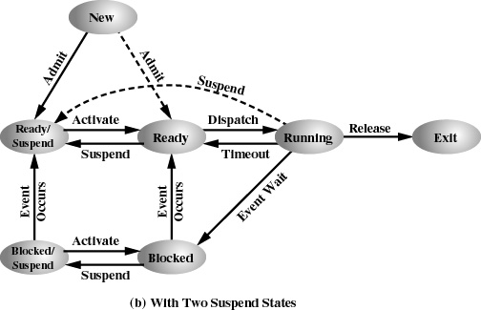
Two Suspend States

Slide 20
Operating System Control Structures
Information about the status of each process and resource
Tables are constructed for each entity the operating system manages
These tables are linked or cross-referenced in some fashion

Slide 21
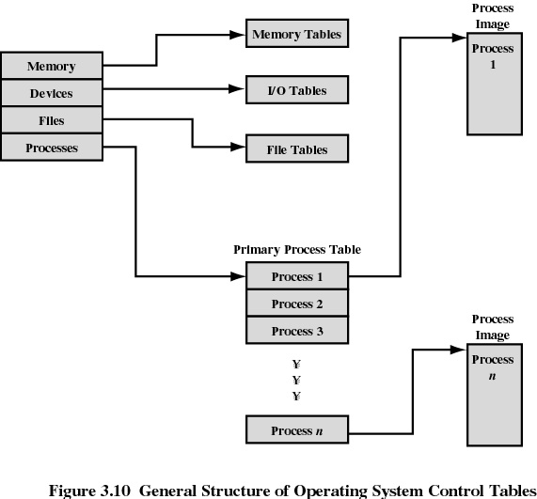

Slide 22
Memory Tables
Allocation of main memory (RAM) to processes
Allocation of secondary memory to processes
Protection attributes for access to shared memory regions
Information needed to manage virtual memory

Slide 23
I/O Tables
I/O device is available or assigned
Status of I/O operation
Location in main memory being used as the source or destination of the I/O transfer

Slide 24
File Tables
Existence of files
Location on secondary memory
Current Status
Attributes
This information is also maintained by a file-management system

Slide 25
Process Table
Collection of process descriptors for each task/process
Each entry contains
process identification (also part of PCB)
  Process ID, parent’s ID, children ID, and owner’s id
pointers to the Process Control Block (PCB) and process image for each process
PCB ➔ Collection of attributes for managing the process
Process image
  Collection of program, data, stack, and attributes
Process includes a set of programs to be executed which are linked together
Related processes are chained together

Slide 26
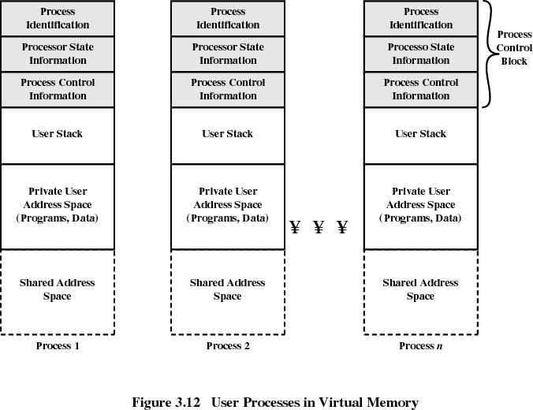

Slide 27
Process Control Block (PCB)
Processor State Information
User-Visible Registers
  Typically, 16 to 32 registers that can be referenced by user programs directly
Control and Status Registers
  Program counter: contains the address of the next instruction
  Condition codes: Result of the most recent arithmetic or logical operation (e.g., sign, zero, carry, equal, overflow)
  Status information: interrupt enabled/disabled flags, exec. mode etc.
Stack Pointers
    each process has one or more LIFO system stacks which is used to store parameters and calling addresses for procedure and system calls. The stack pointer points to the top of the stack.

Slide 28
Process Control Block
Process Control Information
Scheduling and State Information
  needed by the OS to perform its scheduling function:
  Process state: (e.g., running, ready, waiting/blocked, halted).
  Priority: scheduling priority of the process.
  Scheduling-related information: that the scheduling algorithm may need (e.g. the amount of time spent in waiting, the amount of time used during the last time it was running, etc.)
  Event: Id of event the process is awaiting before it can run again
Data Structuring
  A process may be linked to other processes in a queue, ring, or some other structure. For example, all processes in a waiting state for a particular priority level may be linked in a queue. A process may exhibit a parent-child (creator-created) relationship with another process. The process control block may contain pointers to other processes to support these structures.

Slide 29
Process Control Block
Process Control Information (cont.)
Interprocess Communication
  Various flags, signals, and messages may be associated with communication between two independent processes. Some or all of this information may be maintained in the PCB.
Process Privileges
  Processes are granted privileges in terms of the memory that may be accessed, the types of instructions that may be executed, the system utilities and services that may be used, etc.
Memory Management
  includes pointers to segment and/or page tables that describe the virtual memory assigned to this process.
Resource Ownership and Utilization
  Resources controlled by the process such as opened files are indicated. A history of utilization of the processor or other resources may also be included (may be needed by the scheduler)

Slide 30
Modes of Execution
User mode
  Less-privileged mode
  User programs typically execute in this mode
System mode / control mode / kernel mode
or / supervisor mode
  More-privileged mode
  Kernel of the operating system

Slide 31
Process Creation
Assign a unique process identifier
Allocate space for the process
Initialize process control block
Set up appropriate linkages
  Ex: add new process to linked list used for scheduling queue

Slide 32
When to Switch a Process
Clock interrupt
  process has executed for the max. allowable time slice
I/O interrupt
Memory (page) fault
  The address referenced is not in main memory so it must be brought into main memory
Trap
  error occurred
  may cause process to be moved to Exit state
A system call which runs an OS routine
    e.g. fopen() (file open)

Slide 33
Change of Process State
Save context of processor including program counter and other registers
Update the process control block of the process that is currently running
Move process control block to appropriate queue - ready, blocked
Select another process for execution
Update the process control block of the process selected
Update memory-management data structures
Restore context of the selected process

Slide 34
Execution of the OS
Non-process Kernel
  execute kernel outside of any process
  operating system code is executed as a separate entity that operates in privileged mode
Execution Within User Processes
  OS software runs within context of a user process
  Therefore, no context switch, only mode switch
  process executes in privileged mode when executing operating system code

Slide 35
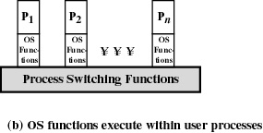
UNIX SVR4
Process Management
Most of the operating system executes within the environment of a user process

Slide 36
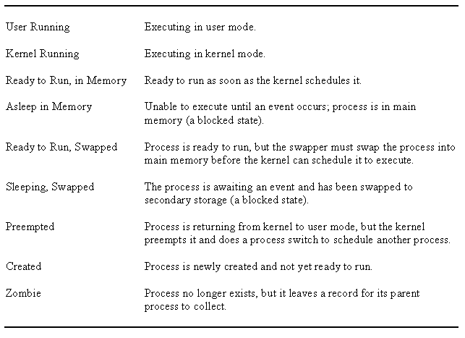
UNIX Process States

Slide 37
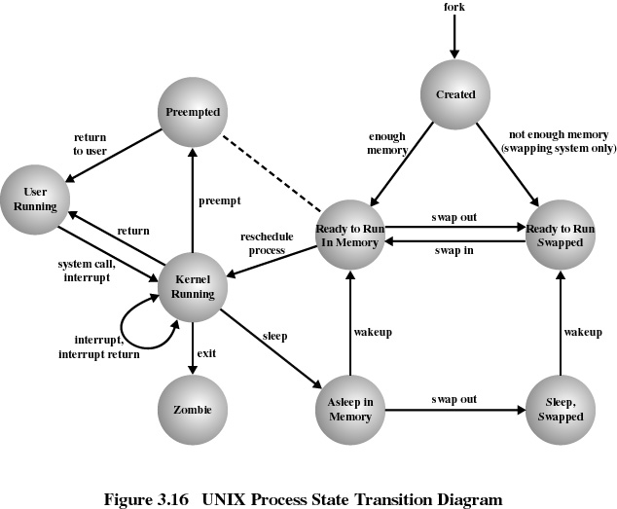
Same state

